Slide 1
Cultivating Equitable, Inclusive, & Diverse School Food Programs
Danielle Findlay, VON OSNP Southwest
Jennelle Arnew, CK Public Health

Slide 2


Land
Acknowledgement

Slide 3


Danielle Findlay
VON Ontario Student Nutrition Program,
Southwest Region
Supervisor of Community Relations

Slide 4







OSNP Gold Standard Framework
Nutrition
Food Safety
Program Planning
Program Sustainability
Equity & Inclusion
Engagement Strategies
Food
Literacy

Slide 5

FoodCorps’ S.H.I.F.T.I.N.G. Tool
Shifting power, resources, and/or access to those most impacted by systemic oppression and/or closest to the work that needs to be done
Honour and trust the wisdom and expertise of students, frontline food service staff, the greater school community, and emerging leaders within our department
Interrupt internalized, interpersonal, and/or systemic oppression
Foster an environment that reflects the diversity of our partner communities and in which everyone can show up and feel brave, supported, and valued for their contributions
Try to create the world we want to see even when we know we might fail
Invest in equity when it comes to budgeting, contracts & vendors, compensation, leadership development, recruitment and promotions
Name and frame racism, ableism, transphobic, and other forms of oppression when we see it
Grant ourselves the time necessary to make decisions and do work that advances justice and minimizes harm
(1)

Slide 6

What are Equity, Diversity, and Inclusion? What do they mean for School Food Programs?

Slide 7
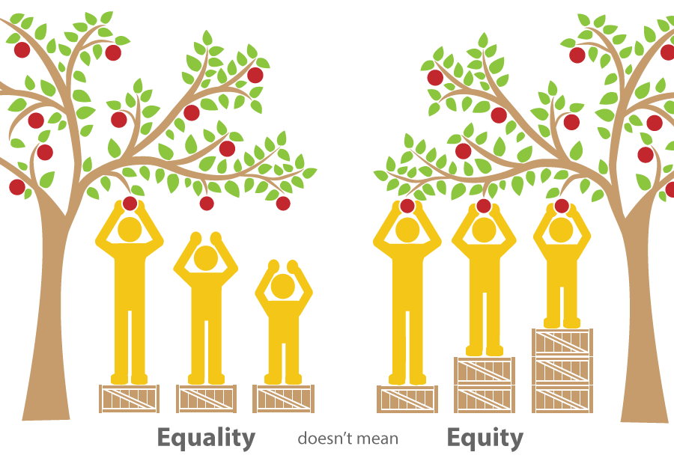
Equity
Equity refers to fair treatment for all people, so that the norms, practices, and policies in place ensure identity is not predictive of opportunities or outcomes. Equity differs from equality in a subtle but important way. While equality assumes that all people should be treated the same, equity takes into consideration a person’s unique circumstances, adjusting treatment accordingly so that the end result is equal

Slide 8

Diversity
Who is represented?
Who has access?
Ethnicity
Gender
Age physical ability
Neurodiversity
SES

Slide 9

Inclusion
Inclusion refers to how individuals experience the program and the degree to which individuals and groups feel embraced and empowered to make meaningful contributions.

Slide 10

What Does Equity Mean for Us?
The goal of providing access to high quality school food for every student

Slide 11

OSNP Equity Framework
Available at: https://osnp.ca/gold-standard/

Slide 12
OSNP Equity Framework
ACTION ITEMS
Identify and eliminate biases and systemic barriers
Support school food environments that are safe and welcoming for all
Ensure inclusive community partnerships and engagement
Seek out and honour the voices of students and families as active participants in the shaping and design of programs. Increase engagement opportunities, including those that offer opportunities for knowledge sharing and those that include parents that may be disengaged from the education system
Work with schools to raise awareness and understanding about the impacts of equity and diversity in school food programs and to provide them with the tools and resources they need to support culturally responsive and inclusive practices
Build the capacity to serve students with disabilities/special education needs and intersecting identities
Work with school board leads (Indigenous Education; Mental Health; Equity, Diversity and Inclusion etc.) to codevelop and integrate actions
Provide staff with relevant professional development opportunities

Slide 13
OSNP Equity Framework
KEY OBJECTIVES AND GOALS
Practicing cultural humility
Gather data to understand true disparities to reach BIPOC and marginalized communities
Reaching rural communities
Emphasizing safe and welcoming spaces
Provide support and reduce barriers for neuro-divergent students
Use an Equity lens when making program decisions

Slide 14



Challenges
Challenges for SNP Practitioners and Supporters:
Budget
Time/
Resources
Knowledge Acquisition/ transfer

Slide 15
Challenges and successes?
What has worked and what hasn’t in your own experience/role?

Slide 16


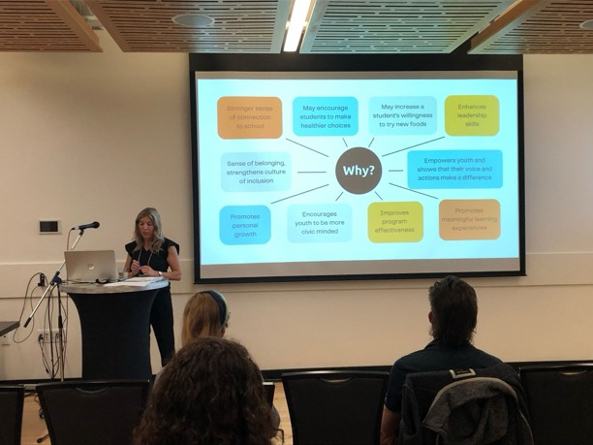
Implementation in OSNP Southwest
Cultural Enhancements/ Food Literacy Resource Pilot
(Ube Pandesal, Filipino Heritage Month)
Special events
(Rice is Nice)
Presenting to school boards about positive and inclusive school food environments and using food as a tool for connection

Slide 17
Implementation in OSNP Southwest
ONGOING:
TO COME:
School Food Delivery Cultural Enhancements with accompanying resources
Student engagement toolkit and pilot project to give students a voice
Work with individuals and groups with specialized knowledge and lived experience to help shape and inform programs
Conversations within our team and learning opportunities for our staff
Resource for schools/SNPs to support students while fasting
Resource for schools/SNPs to support neurodivergent students with different food needs

Slide 18

Meaningful Conversations
We are not the experts
Work with your community:
  Settlement Workers in Schools (SWIS)
  Local Immigration Partnership
  School Boards: equity officers, student groups, Cultural Groups/associations
  Webinars
  Knowledge holders
  Professional Development Opportunities

Slide 19

Know Your Community
What is available in your community?
  School board student census
  StatsCan census
  Connect with Public Health
  MCCSS sociodemographic data
  Province of Ontario Data Catalogue: School Information and Student Demographic
  Data collected by community partners
(2)

Slide 20

Considerations
PREVENTING
TOKENISM

Slide 21
Equity, Diversity, & Inclusion
How else can we achieve this?
What else do we need to consider?
How else can we build understanding?
What are we missing?

Slide 22

National School Food Policy
OBJECTIVES
Guided by the Policy's principles, the following objectives help support the long-term vision of every child having access to nutritious food in school.
(3)

Slide 23
National School Food Policy
Work Progressively towards the long-term goal of
universal access
Building constructively on the work of existing funders and school food programs
Expanding school food programs to communities that are underserved and/or where programming does not currently exist
Prioritizing communities and populations that face barriers to accessing nutritious food and which are most affected by food insecurity, including those that are Indigenous, Black, or from other racialized groups; living in rural, remote or isolated areas; and in immigrant, single-parent, or low-income households
Ensuring that the physical, financial and other barriers to participation are reduced or mitigated, especially for marginalized populations
Striving to serve meals that are free at the point of participation, such that any contribution on the part of students or families takes place privately and separately from meal or snack service, and ensuring that meals are offered in an environment designed to minimize or eliminate stigma
(3)

Slide 24
National School Food Policy
Expand investment in school food so that programs can operate sustainably
Enhancing and expanding, and without displacing, existing sources of funding for school food programs with the goal of expanding their reach and capacity
Exploring how different funding models could be implemented to further expand access to school food programs
Supporting investments in infrastructure and staffing to procure, grow, deliver, store, prepare, and serve safe and healthy food at schools in a supportive environment
Taking action to encourage sustainable practices, including efforts to reduce food loss and waste through prevention and diversion strategies and behaviours
(3)

Slide 25
National School Food Policy
Help children meet their nutritional and health needs, develop healthful food-related behaviours and attitudes, as well as food and nutrition knowledge and skills
Fostering a healthy school food environment, aligning meals, snacks, experiences, and education with Canada's Food Guide and provincial or territorial nutrition guidelines
Valuing the importance of age-appropriate and hands-on learning opportunities related to food, nutrition and/or food systems
Promoting positive food-related behaviours and attitudes, such as enjoying meals and snacks with others, being open to trying new foods and taking time to eat
Safeguarding against marketing food and beverage brands and highly processed foods and beverages to children and increasing awareness of the impacts of food marketing on food choice
Striving to promote food literacy and food skills, including: strengthening knowledge of the connections between food and health, culture, and the environment; healthy eating; and, reducing food waste
Ensuring food is safe to minimize the risk of pathogens, and that relevant health and safety-focused regulations are followed
(3)

Slide 26
National School Food Policy
Promote programming that is culturally appropriate, relevant, and inclusive
Striving to provide children with opportunities to learn about other cultures
Ensuring that information on school food programming, including how students and families can participate, is accessible and clear
Food offerings reflect a mindfulness of dietary needs and allergies and the importance of including foods that reflect students' cultural identifies (for example, country, halal and kosher food)
Leveraging the experience and expertise of First Nations, Inuit and Métis partners and community leaders, such as Elders, to ensure programs are culturally appropriate
Involving students in menu planning or food preparation, where possible
Ensuring opportunities for input and feedback from students, parents and the community
(3)

Slide 27
National School Food Policy
Create opportunities for local economies and reflect of local and regional circumstances
Maximizing opportunities to source food locally and foster connections with local food producers, hunters and harvesters, processors, and suppliers
Benefiting local economies and job creation
ensuring partnerships (for example, with businesses and corporations) are mutually beneficial and support healthy living
Striving to support the participation of under-represented groups in the Canadian agriculture and food sector
(3)

Slide 28
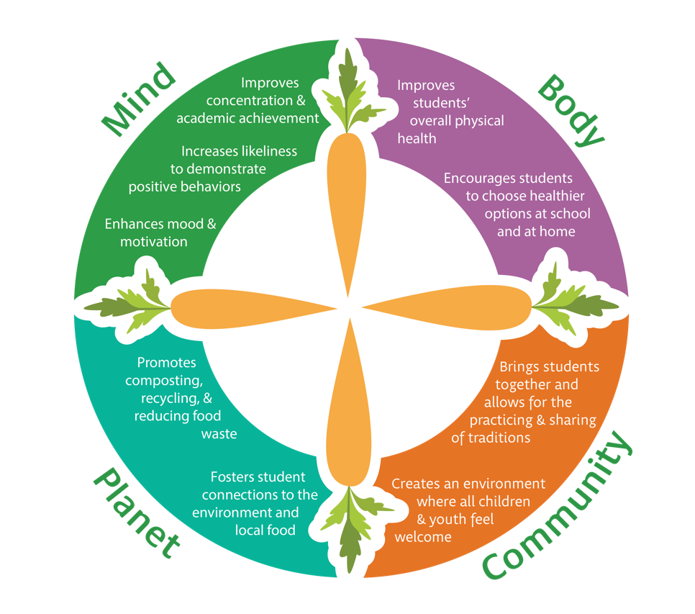
Food is a tool for Connection

Slide 29
Thank you!

Slide 30
References
Shifting: Goal/Project Planning Template for school Nutrition Programs . FoodCorps. (n.d.). https://foodcorps.org/wp-content/uploads/2023/03/PY23_SHIFTING-tool_-School-Nutrition-Programs.pdf
2023 student census. Greater Essex County District School Board. (n.d.). https://www.publicboard.ca/en/about-gecdsb/2023-student-census.aspx
Canada, E. and S. D. (2024, June 20). Government of Canada. Canada.ca. https://www.canada.ca/en/employment-social-development/programs/school-food/reports/national-policy.html

