Slide 1
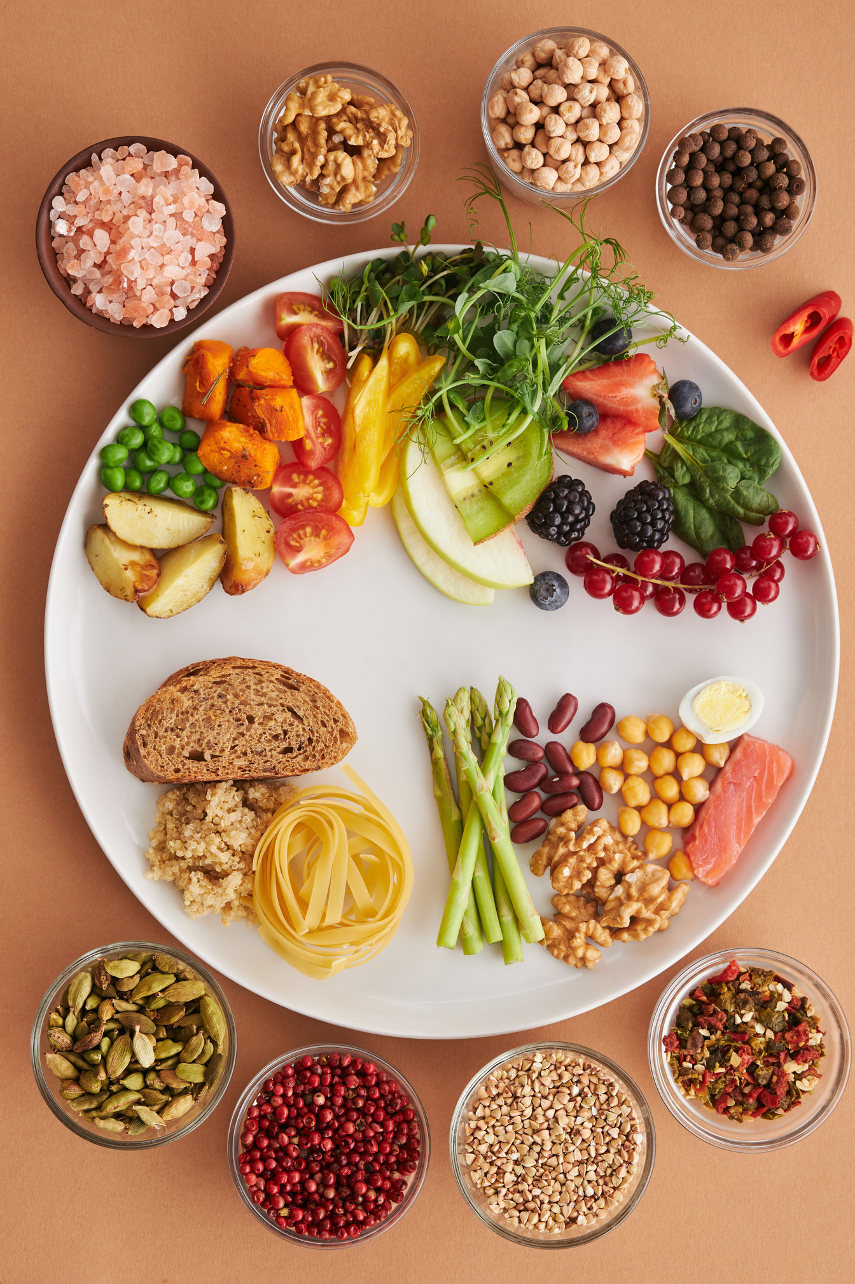

CULTIVATING EQUITY, INCLUSIVE AND DIVERSE SCHOOL FOOD PROGRAMS
By: Jennelle Arnew (she/her) RD, MSc

Slide 2

Agenda
  Equity, Inclusion and diversity
  Why it matters
  Strategies to integrate EDI practices into programs
  Creating a safe space for all
  Resources and support

Slide 3
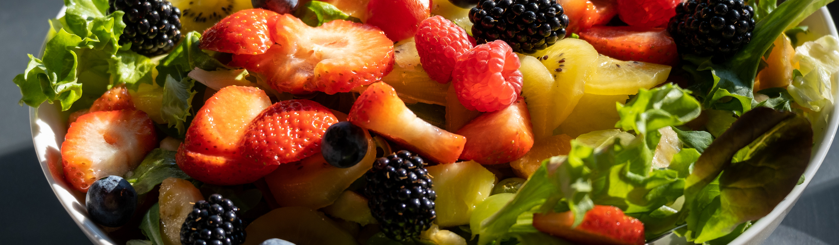
Introduction

Slide 4


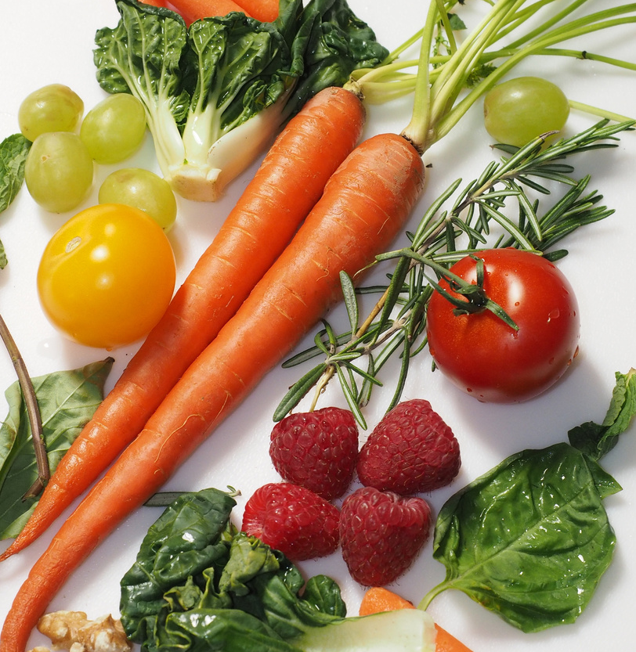
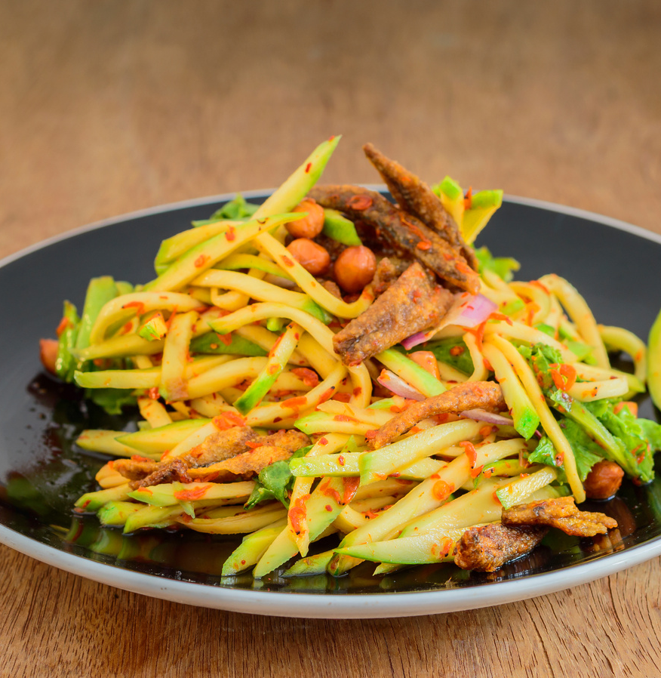
What is one of your earliest childhood memories connected to food?
  Who were you with?
  What emotions does it bring back for you?
  Can you remember what you were eating?

Slide 5

Diversity in Ontario
~16% of the total population in Ontario speak a non-official language most often at home
~30% of the total population in Ontario identified as immigrants
~3% of the total population in Ontario identified as Indigenous
~34% of the total population in Ontario identified as a member in a ‘visible minority’
[1]

Slide 6
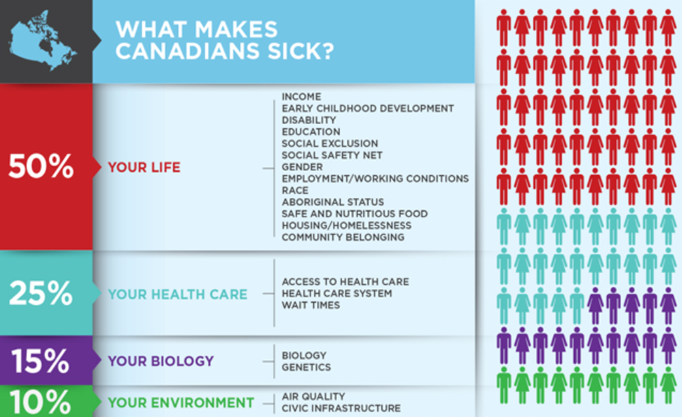

Slide 7


NATIONAL FOOD POLICY: GUIDING PRINCIPLES
  Accessible
  Health Promoting
  Inclusive
  Flexible
  Sustainable
  Accountable
[2]

Slide 8
WHY IT MATTERS
  Supports Health and Wellness
  Increases access to nutritious food
  Provides local and regional flexibility
  Builds social connections
  Opportunity to highlight cultural diversity
  Integration of experiential learning
[2]

Slide 9
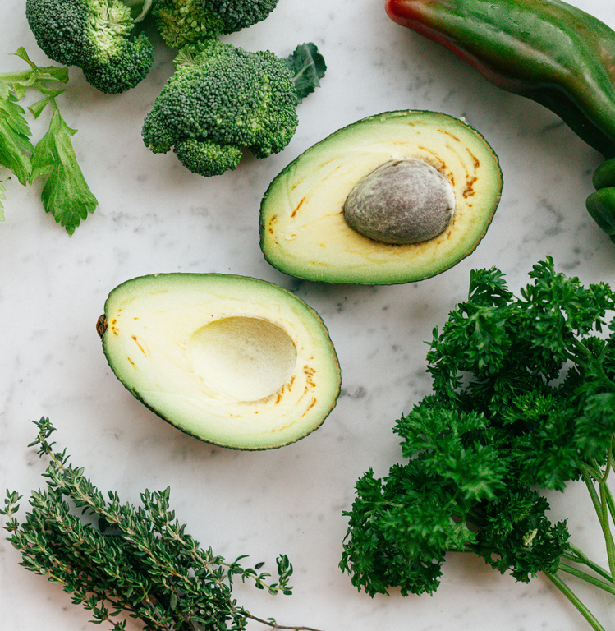
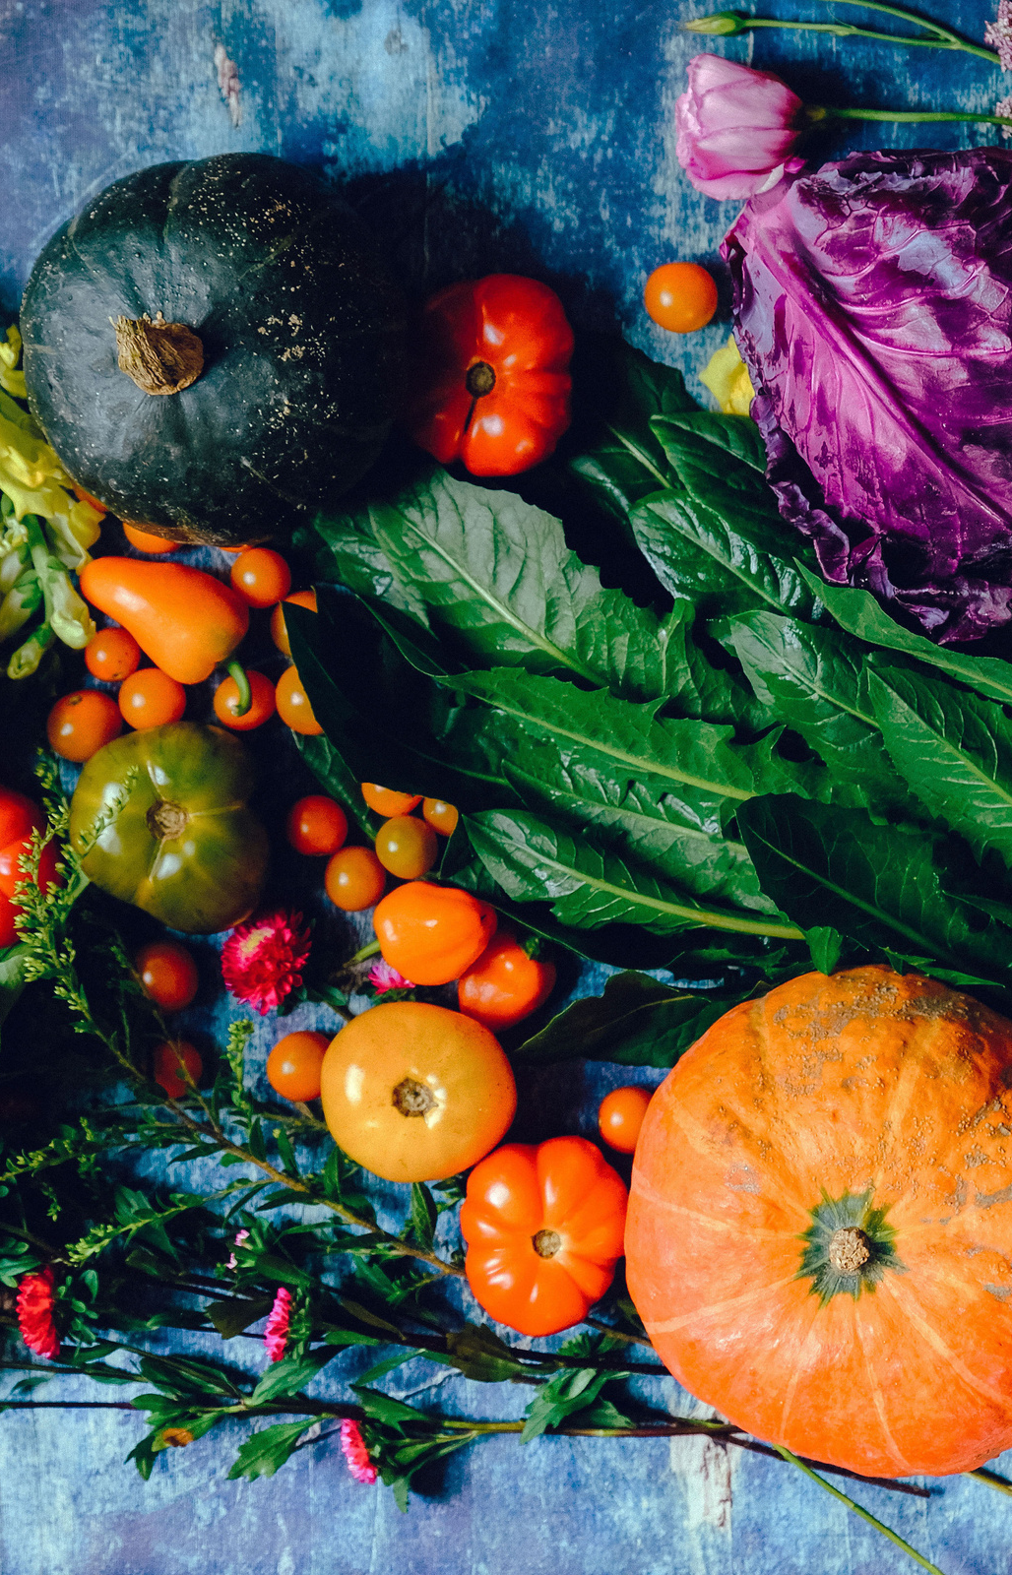
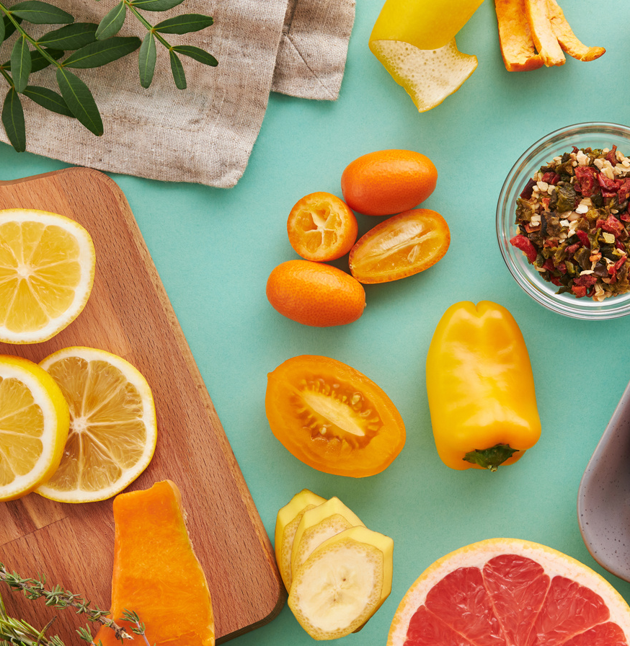
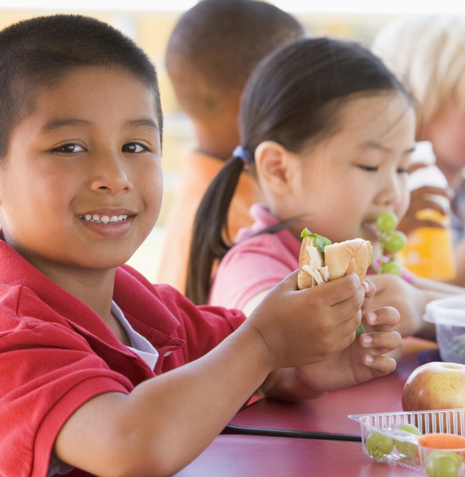
EQUITY, INCLUSION AND DIVERSITY
When programs are integrating these principles, what does that look like?

Slide 10
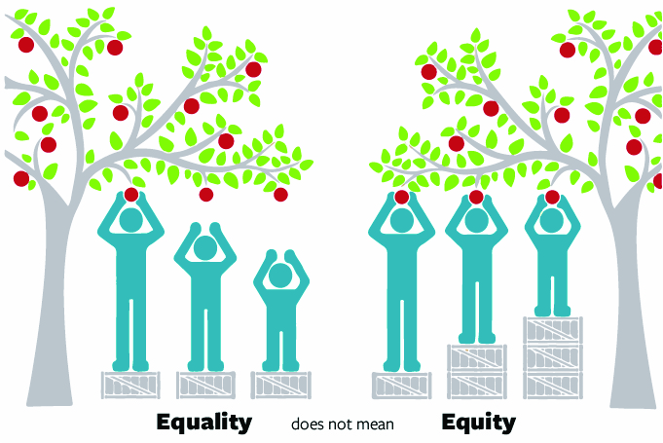
Equity vs. Equality: What’s the Difference?
Equality: means each individual or group of people is given the same resources or opportunities.
Equity: recognizes that each person has different circumstances and allocates the resources and provides the opportunities needed to reach an equal outcome.
Image Source: Health Equity | Florida Department of Health in Escambia (floridahealth.gov)

Slide 11
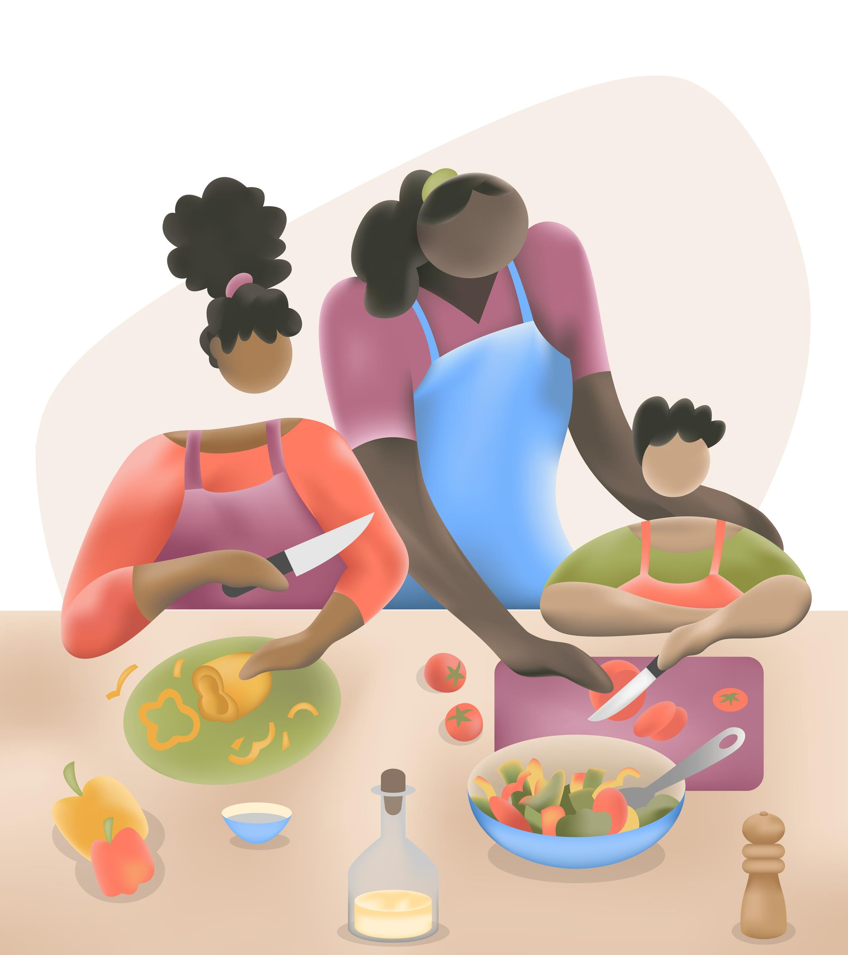
Can you think of how schools require different resources so that all students have access to nutritious foods?

Slide 12
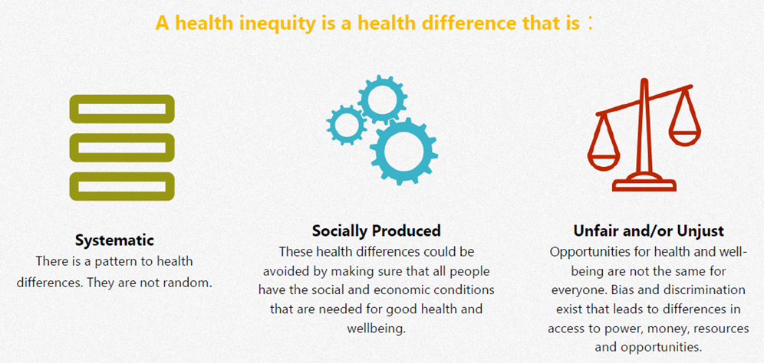
What is health equity?
“…all people can reach their full health potential and are not disadvantaged from attaining it because of their race, ethnicity, religion, gender, age, social class, socioeconomic status or other socially determined circumstance.” (Ministry of Health and Long-Term Care, 2017)
[3]

Slide 13

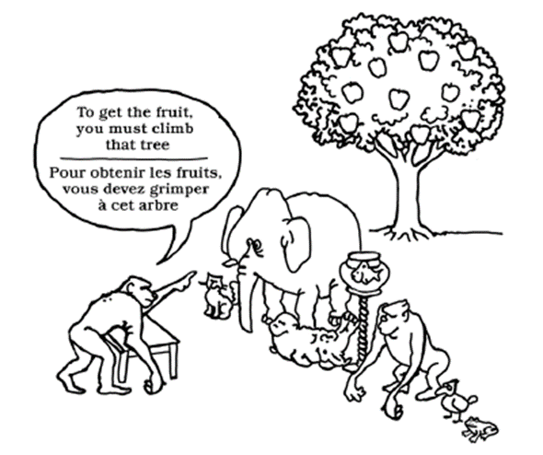
Systematic Barriers
Can you think of any systematic barriers that create inequities in SNPs?

Slide 14
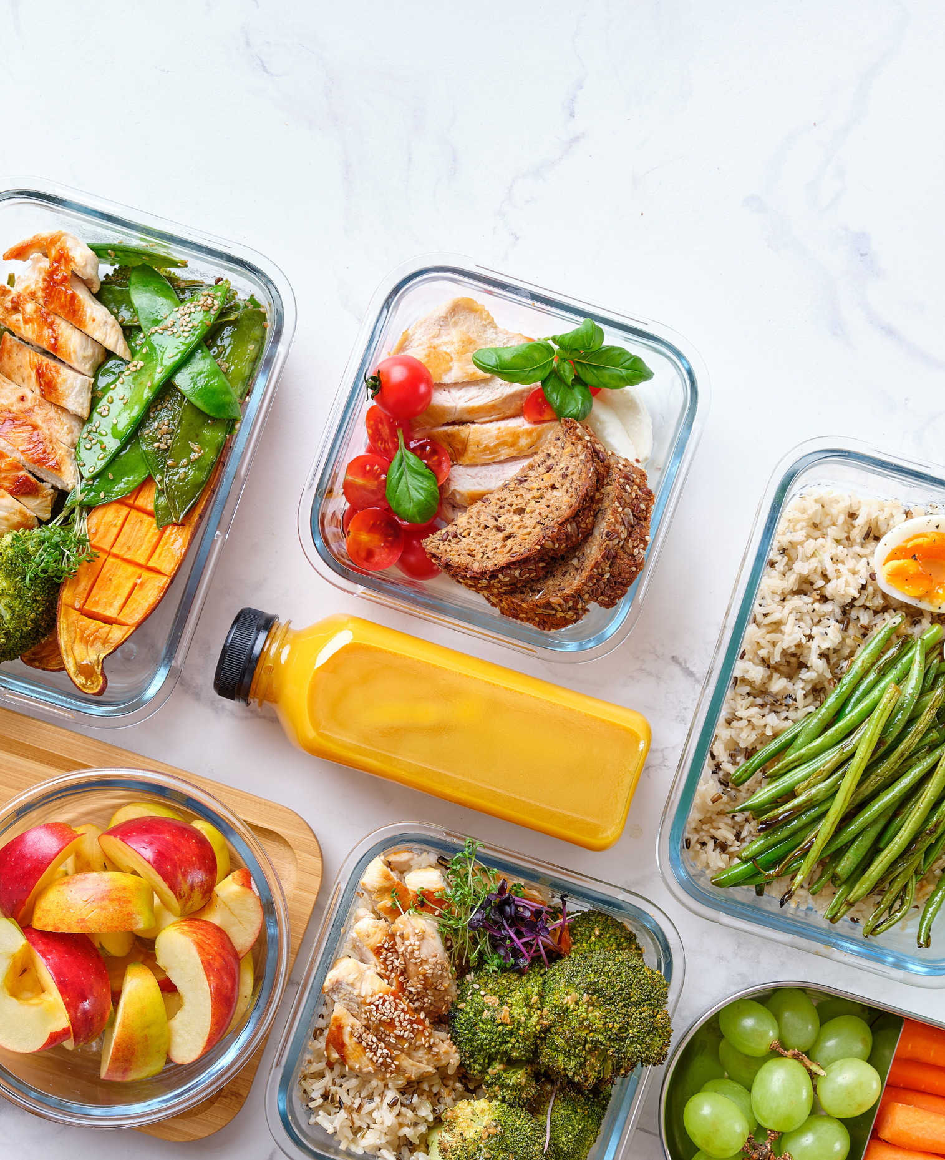
DIVERSITY
Programs that prioritize culturally important foods:
  Welcoming and inclusive spaces
  Provides opportunities to have preferred foods for all students
  Reduces barriers
  Creates opportunity for students to embrace new foods
  Generates discussions and learnings about food from different cultures
[4]

Slide 15
DIVERSITY
  Examples:
    Rice is Nice event
    Integrate culturally important foods into menus
    Taste tests
    Ask students/families

Slide 16
Examples of Culturally Important Foods
Protein
Labneh
Hummus
Whole Grains
Chapati
Naan
Okra
Asian Pear
Bean Dips
Corn
Bannock
Fruits and Vegetables
Beets
Mango
Squash
Edamame
Nori
Other
Tabbouleh
Baba Ghanoush
Tamales

Slide 17
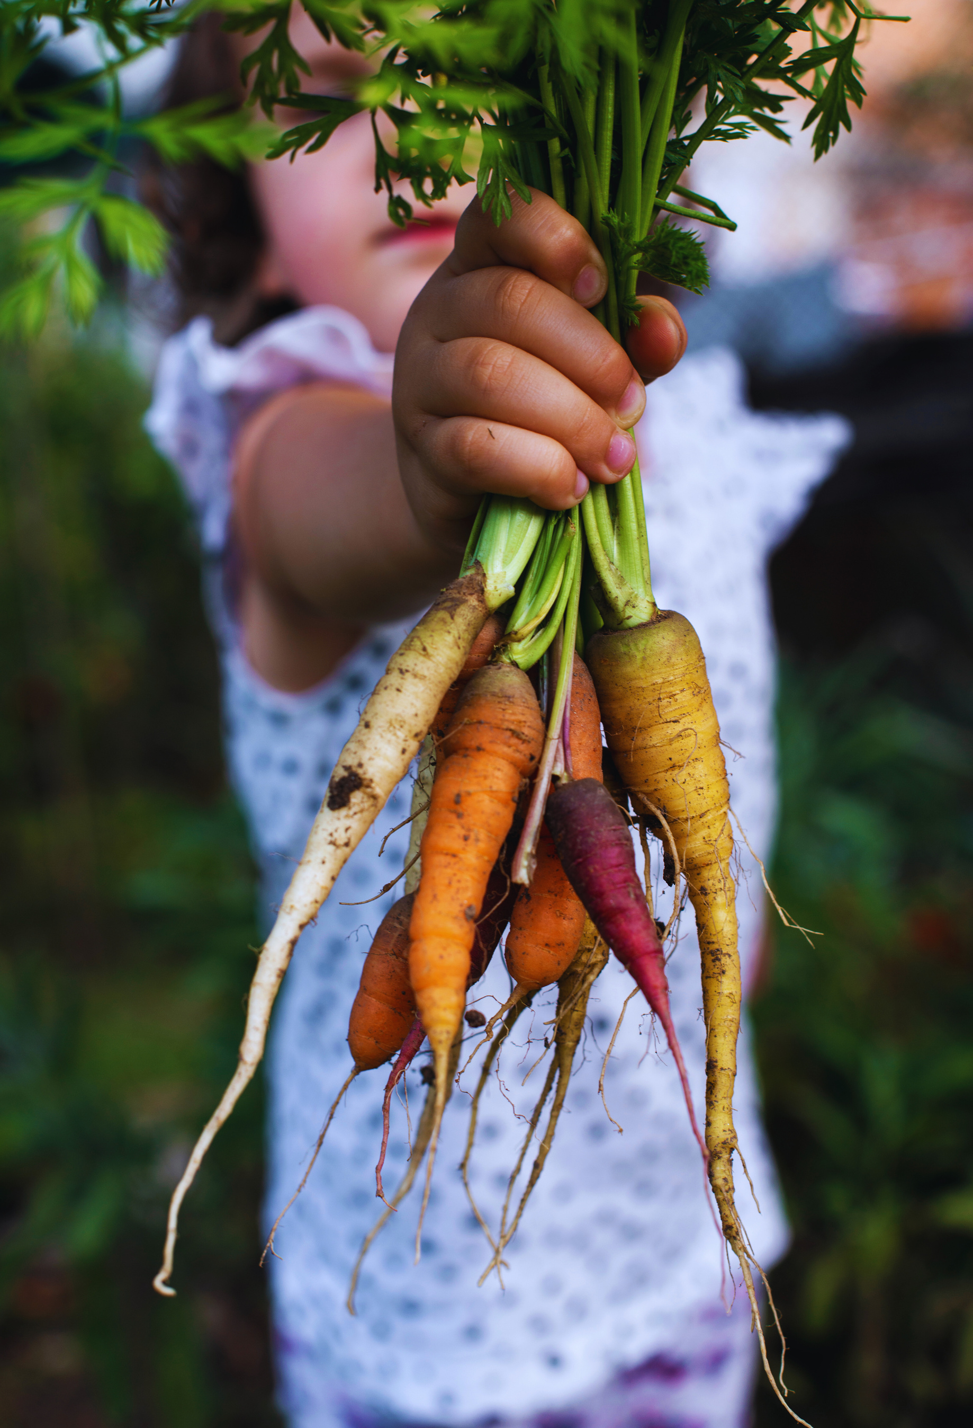
INCLUSION
“Children and youth have access to culturally appropriate, relevant and inclusive school food programs that engage students and the broader community.”
  Inclusive food options help students feel a sense of belonging in their school and community.
  Fosters a safe environment for exposure and exploration of new foods.
  Give students the opportunity to bond and learn from their peers.
  Adds more nutrition diversity into their diets.

Slide 18
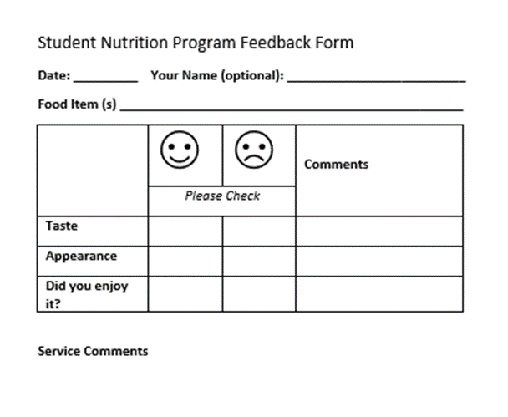

INCLUSION
    Include Students in Menu Planning i.e. Youth Advisory Councils
    Work Collaboratively
    Use positive messaging
    Monitor student feedback and comments

Slide 19

Promoting a positive School Nutrition Environment
Be a role model
Engage with students and ask for their input
Use positive messaging/ education
Neutral
exposure
Food Literacy i.e., School
Gardens/cooking program
Special
Lunches/Events
Division of Responsibility

Slide 20
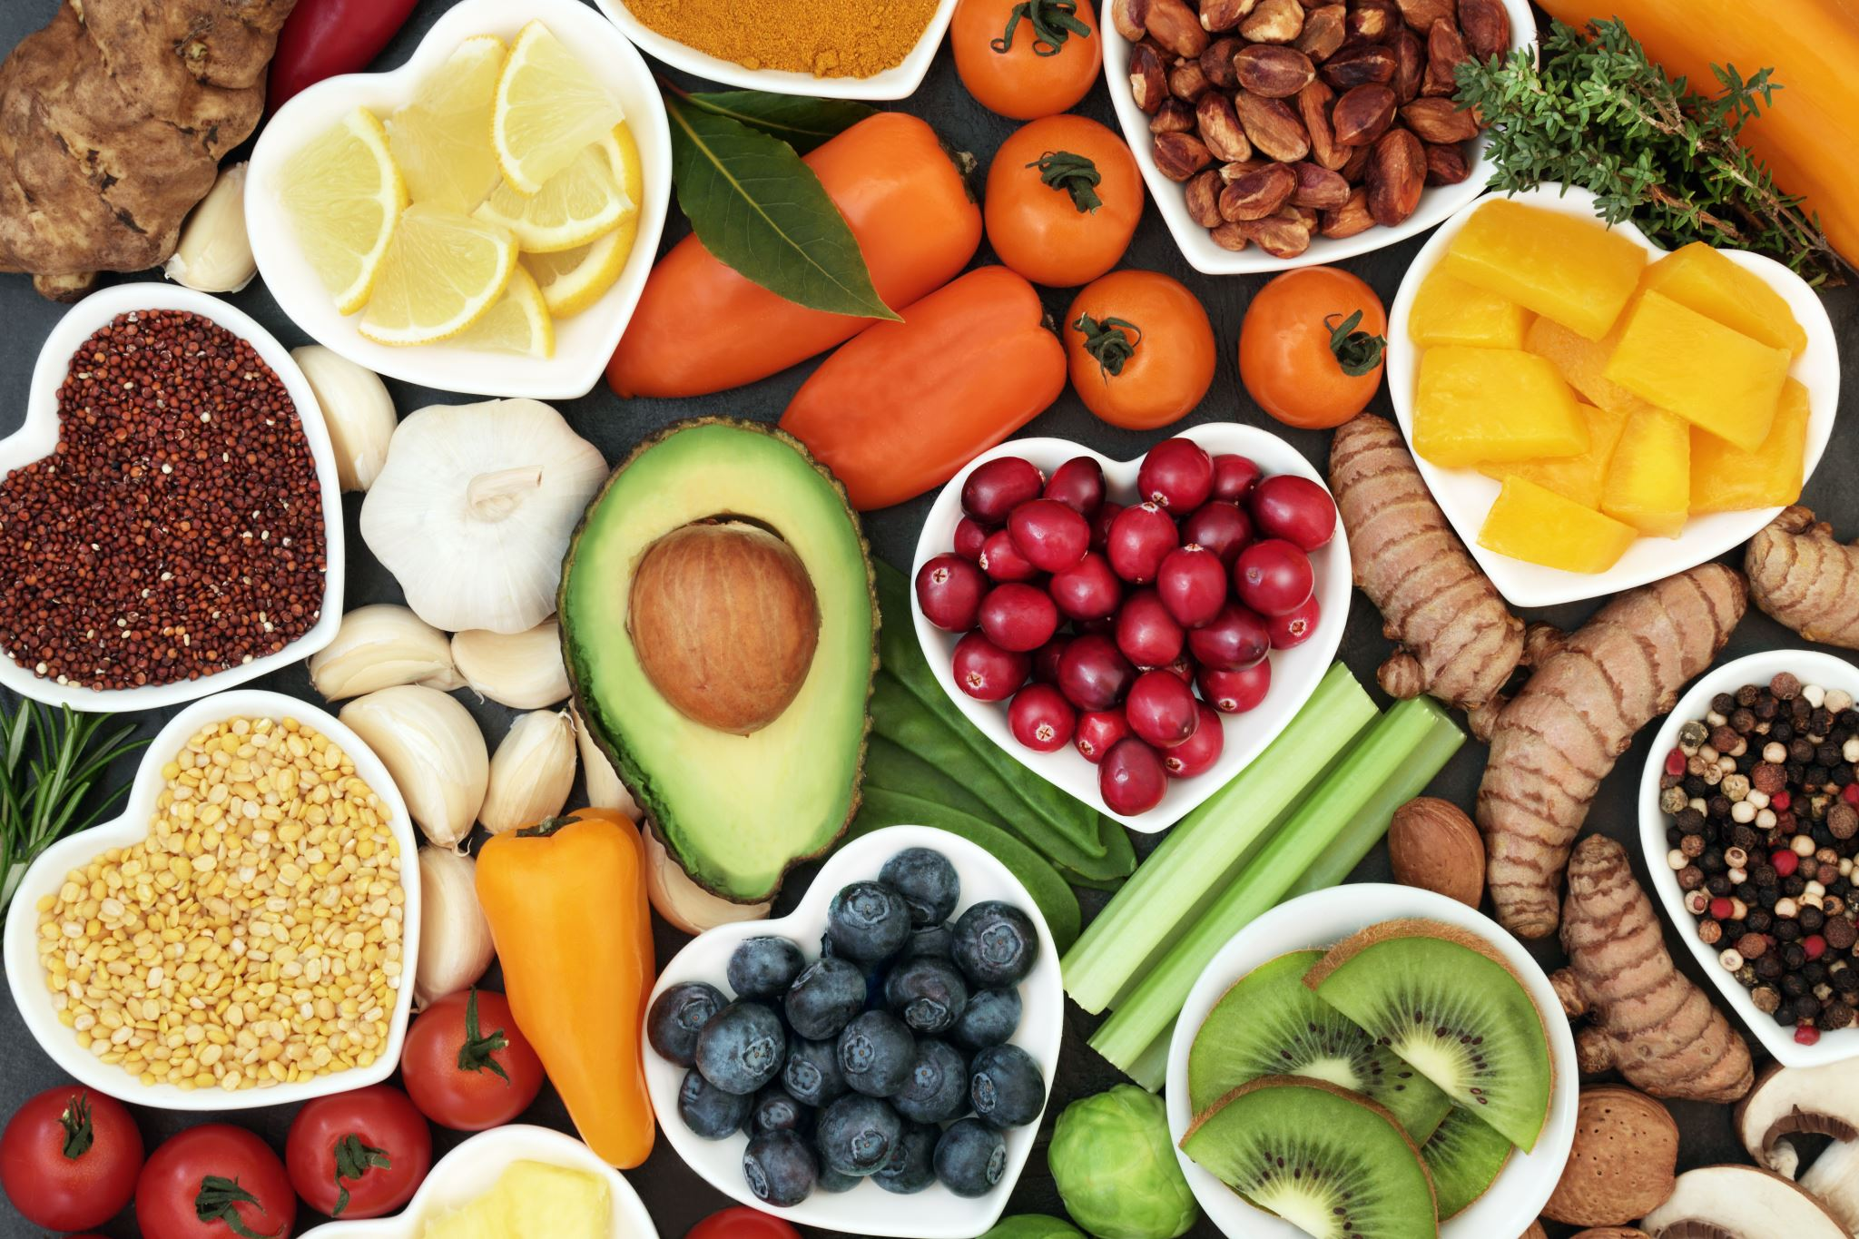
Resources and Supports
Bright Bites offers free resources, lesson plans and activity ideas.
Cookspiration – recipes and resources managed by Dietitians of Canada
UnlockFood.ca – blog posts and nutrition information managed by Dietitians of Canada
Guelph Family Health Study – recipes and resources
You’re the Chef (YTC) program is a classroom program designed for students in grades 5-8 to teach students about cooking and food handling skills. Check with your local health unit!
Canada’s food guide toolkit for educators provides activities to help students learn food skills, develop healthy eating patterns, and understand Canada’s food guide.
Ontario Dietitians in Public Health provides resources on ways to create supportive food environment and information for parents/caregivers. To find out more visit: School Nutrition Resources (odph.ca).

Slide 21
Reach out for support
Connect with your SNP lead agency
Reach out directly to your local health unit’s RD
Find your local health unit at: Health Services Locator Map | Public Health Ontario

Slide 22
References
Statics Canada. Profile Table: 2021 Census of Population- Ontario [Province]. Available from: Profile table, Census Profile, 2021 Census of Population - Ontario [Province] (statcan.gc.ca)
Ministry of Employment and Social Development. Government of Canada: National School Food Policy [Internet]. 2024. Available from: National School Food Policy - Canada.ca
Ministry of Health and Long-Term Care. Ontario public health standards: requirements for programs, services, and accountability, 2018. Toronto, ON: Queen's Printer for Ontario; 2018. Available from: Health Equity Guideline, 2018 (ontario.ca)
Government of Canada. Canada’s Food Guide: Cultures, food traditions and healthy eating [Internet]. 2020. Available from: Cultures, food traditions and healthy eating - Canada's Food Guide.

Slide 23

THANK YOU
Contact:
jennellea@chatham-kent.ca

