Slide 1






Vision Conference 2024
Student Nutrition Ontario
October 2024

Slide 2

ABOUT SNO
  Student Nutrition Ontario is made up of representatives from 14 Lead Agencies who administer provincial grant funds.
  These funds help to develop and implement healthy breakfasts, snack and lunch programs across the province.
OUR MISSION
To collaborate and provide a unified voice for student nutrition across the province, ensuring every child has equal opportunity to eat, learn, and succeed.
OUR VISION
That every student across the province has access to nutritious food and learns to make healthy choices.

Slide 3
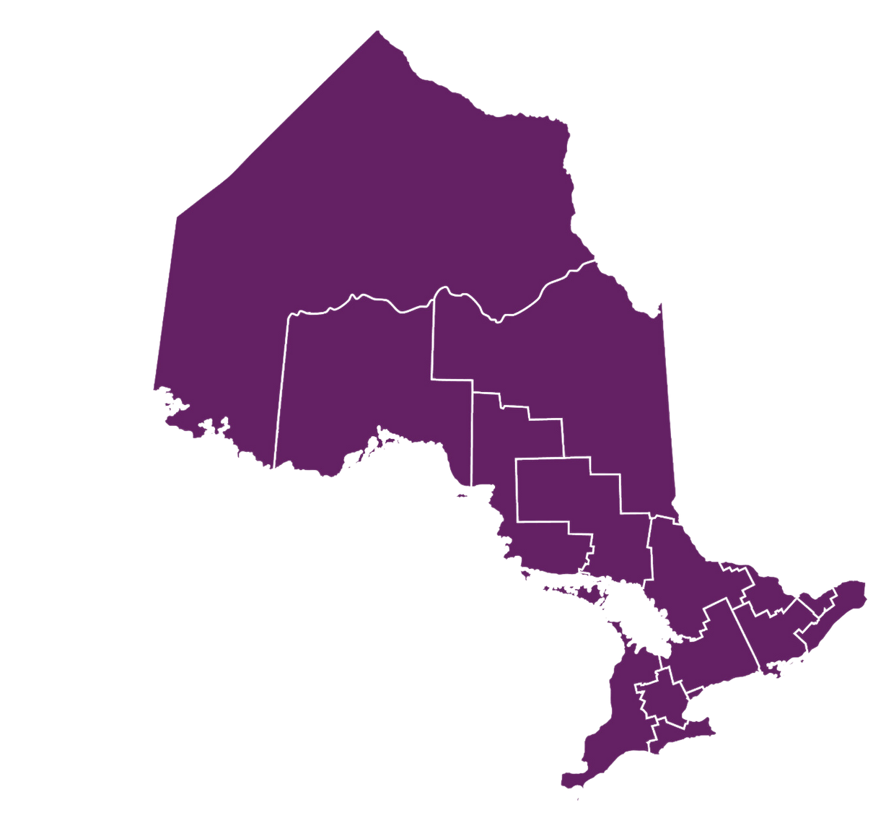

LEAD AGENCIES
SOUTH WEST - Victorian Order of Nurses
NIPISSING-MUSKOKA-PARRY SOUND - Community Living North Bay
SUDBURY-MANITOULIN - Sudbury Better Beginnings Better Futures Association
ALGOMA - Algoma Family Services
THUNDER BAY & DISTRICT - Canadian Red Cross
TIMMINS & DISTRICT - Canadian Red Cross
NORTH WEST - Northwestern Health Unit
EASTERN ONTARIO - Upper Canada Léger Centre For Education and Training
OTTAWA - Ottawa Network for Education
SOUTH EAST - The Hastings and Prince Edward Learning Foundation
CENTRAL EAST - Peterborough Child & Family Centres
TORONTO - Toronto Foundation for Student Success
CENTRAL WEST - YMCA of Three Rivers
HAMILTON-NIAGARA - Haldimand Norfolk R.E.A.C.H.
PROVINCIAL
REGIONS

Slide 4

SNO SUPPORTS & SERVES:
5249
SCHOOL & COMMUNITY-BASED NUTRITION PROGRAMS
895,116
STUDENTS
142,131,145
NUTRITIOUS MEALS PER YEAR
Funding comes from the Government of Ontario, National and Provincial partners, community donors, parental contributions, and others.
*As of April 2024

Slide 5
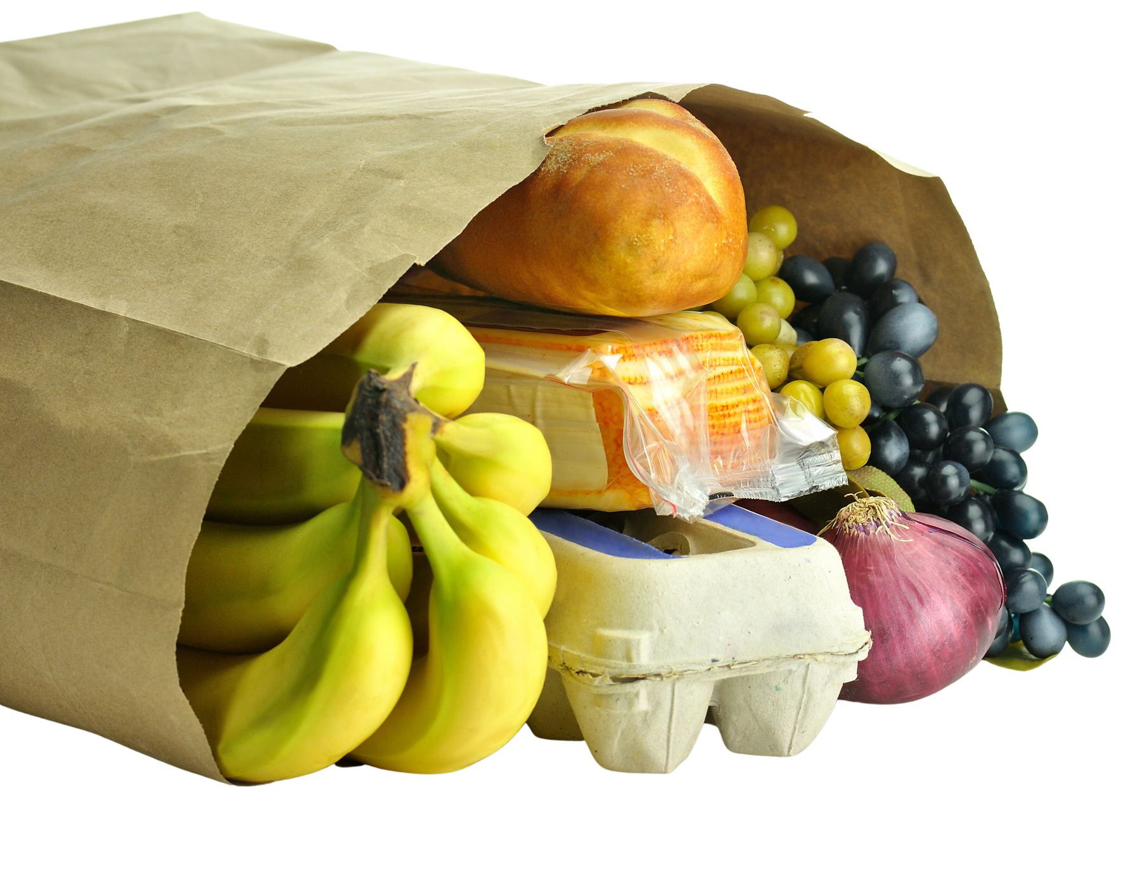


Past, Present, Future
​
​

Slide 6


Past
  SNO came together in 2008 as a Network
  Shared best practices and resources
  Organized Provincial initiatives
  Ministry funding for FLC positions in 2013
  Ministry Funding 2016-2019
AFTER-SCHOOL PROGRAMS

Slide 7
Present
  We continue to work together as a Network advancing Ontario initiatives
  Ministry continues to fund us
  Partnerships
  Shared Resources
AFTER-SCHOOL PROGRAMS

Slide 8
Community Partnerships/Advisory Flow Chart
C:\Users\cvmcd\OneDrive - Toronto Foundation for Student Success\Desktop\May 2024 Advisory SNO flowchart and contacts.docx
AFTER-SCHOOL PROGRAMS

Slide 9


Future

Slide 10




Redesign of SNO
What does Redesign look like
What will be the impact on SNO
What’s Next

Slide 11
National School Food Program
We Know the Federal Government has made a commitment to a National School Food Program
They are working with the Provinces and Territories to sign contract
We will hear for Member of Parlement a bit later today for an update

